Slide 1
WEB REQUEST LIFE CYCLE
​

Slide 2
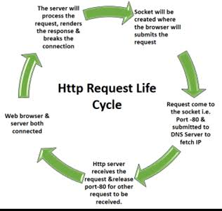
Life cycle

Slide 3
Life cycle
1. You type maps.google.com into the address bar of your browser.
2. The browser checks the cache for a DNS record to find the corresponding IP address of maps.google.com.
DNS(Domain Name System) is a database that maintains the name of the website (URL) and the particular IP address it links to. Every single URL on the internet has a unique IP address assigned to it. The IP address belongs to the computer which hosts the server of the website we are requesting to access.
The primary purpose of DNS is human-friendly navigation.
3. If the requested URL is not in the cache, ISP’s DNS server initiates a DNS query to find the IP address of the server that hosts maps.google.com.

Slide 4
Life cycle
4. The browser initiates a TCP connection with the server.
Once the browser receives the correct IP address, it will build a connection with the server that matches the IP address to transfer information. Browsers use internet protocols to build such connections.
5. The browser sends an HTTP request to the webserver.
6. The server handles the request and sends back a response.
7. The server sends out an HTTP response.
8. The browser displays the HTML content (for HTML responses, which is the most common).
Notes:
This slide is only for the trainer… You can display the poll from GTM and after the poll is taken, share the result, connect the poll result with the topic. Once done, you can hide the poll so that the PPT is visible.
I have created the poll in the GTM webinar.

Slide 5


